Slide 1
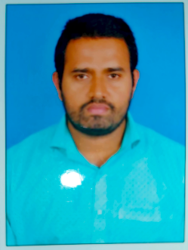



TECHNICAL ARCHITECT – APPLICATION DEVELOPMENT
Ram PRASAD HACHOOLI
Technical ARCHITECT
Work Experience
13 years of IT Experience with more than 4 years as Technical Architect involve in Architecture, development & deployment in for Microsoft Office 365 with Power Platform
Expertise in developing custom apps(Power Platform with AI) and deploying in Microsoft Market place/Microsoft App Source & also enables to creates new initiatives within Microsoft Practice Teams
Architecture detailed technical components for product utilizing high-level and Low-level design, solution meets functional requirement & non-functional requirements (NFR).
Implemented best practices to software development division to enhance product definition and application customization
Publishing and deploying of custom apps with Microsoft Teams and other platforms.
Ram Prasad Hachooli currently working as a Technical Architect with various domains such as Healthcare & Manufacturing industry for Implementing Microsoft Office 365 with Power Platform
Expertise in handling databases and collaboration with Cross functional teams & Worked on RDBMS Databases such as MS SQL, Oracle
Expertise skills on M365, SharePoint, Azure , Dotnet & effective maintaining the project within the scope and budget
Skill set
Projects
Microsoft Power Platform Suite – Power apps, Power Automate, Virtual Agent, Power BI & Power Automate Desktop
MOSS 2007,SharePoint 2010,2013 and Online,
Office365
Nintex RPA with Office 365
National Reliable Lending
Red Lion Hotel
Dorman
Pulse – Intranet Application
Dotnet ,C#,
Asp.net,
MVC,
Azure(Azure ML,Azure BLOB,Logic Apps,Site2Site etc), AWS(EC2,Lambda) & Servicenow
Data Science & AI

